Slide 1


System Config Instructions:
https://ti.to/xamarin/dev-days-twin-cities/en
Clone or Download Code:
https://git.io/vPFem

Slide 2
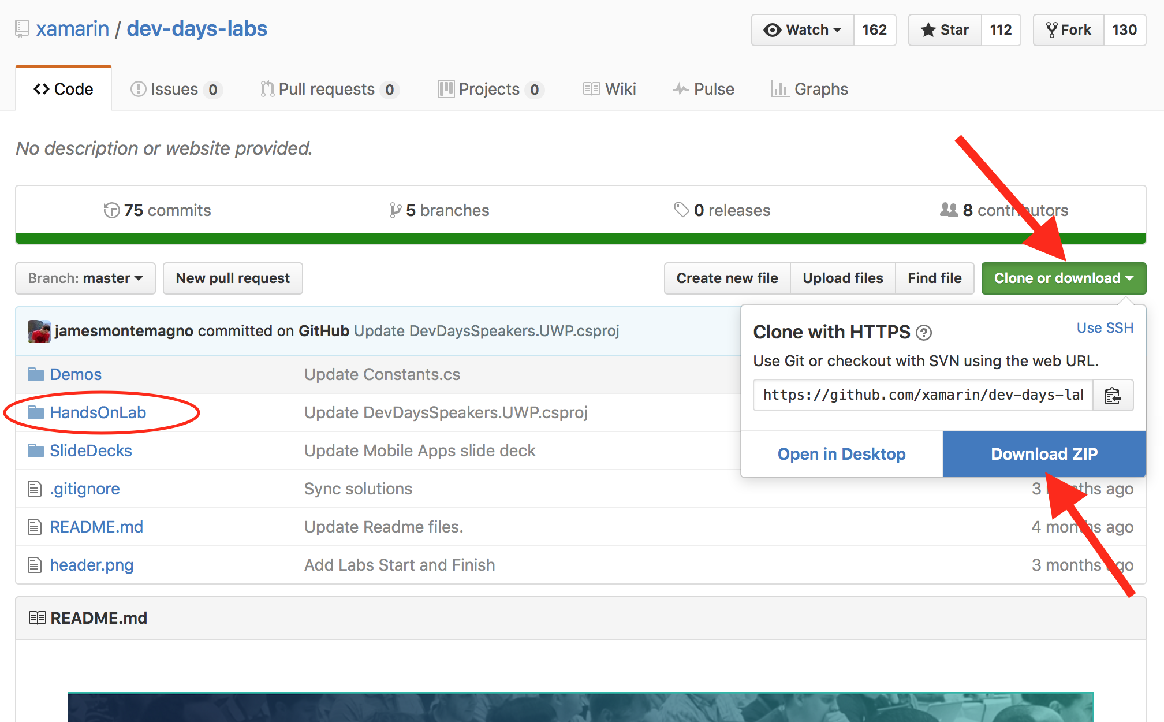
Clone or Download:
https://git.io/vPFem

Slide 3
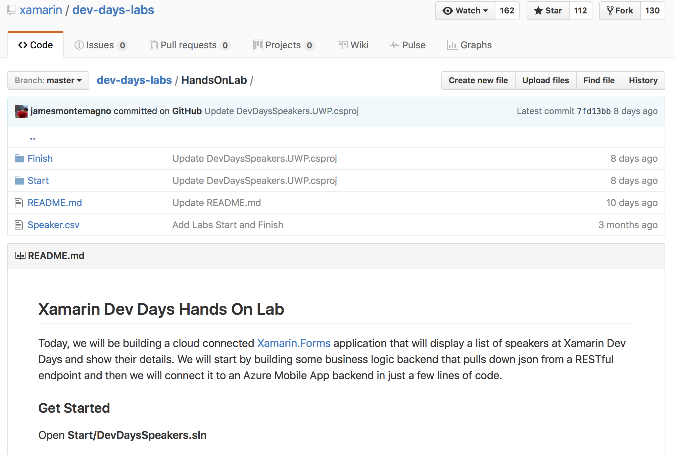
Clone or Download:
https://git.io/vPFem

Slide 4

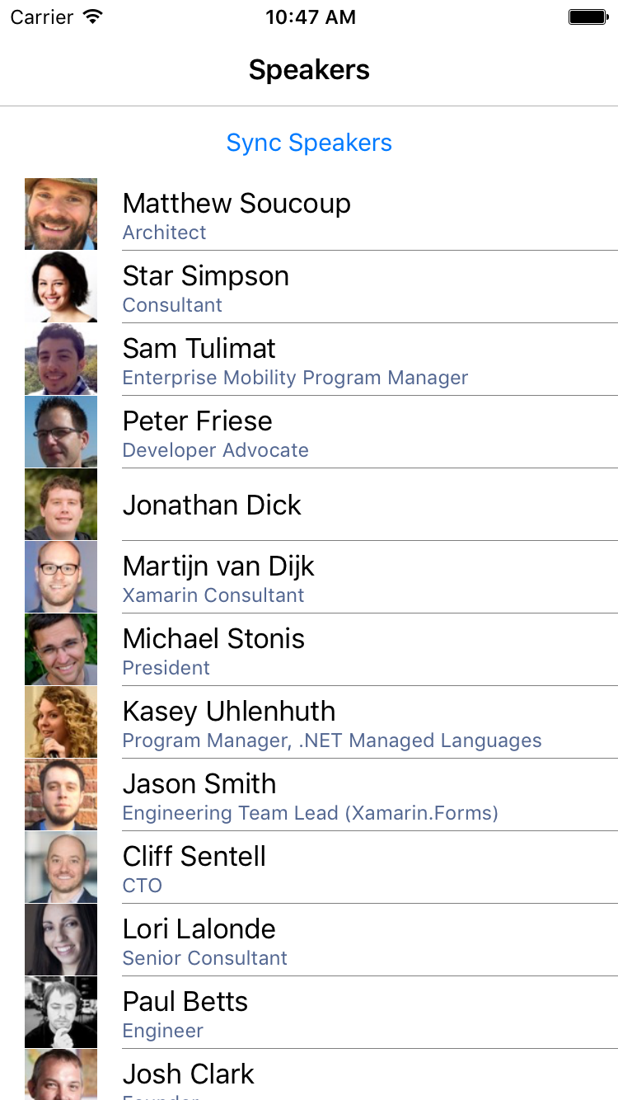
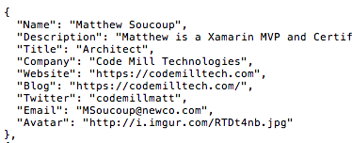
Clone or Download:
https://git.io/vPFem
Notes:
This afternoon we will be building a cloud connected Xamarin.Forms app that displays a list of Xamarin Dev Days speakers and shows their details.
We will start by building a business logic backend that pulls down data in JSON format from a RESTful endpoint ...

Slide 5
Clone or Download:
https://git.io/vPFem
Notes:
This afternoon we will be building a cloud connected Xamarin.Forms app that displays a list of Xamarin Dev Days speakers and shows their details.
We will start by building a business logic backend that pulls down data in JSON format from a RESTful endpoint ...
And then as an alternative we will connect it to a Microsoft Azure Mobile App backend with just a few lines of code.

Slide 6
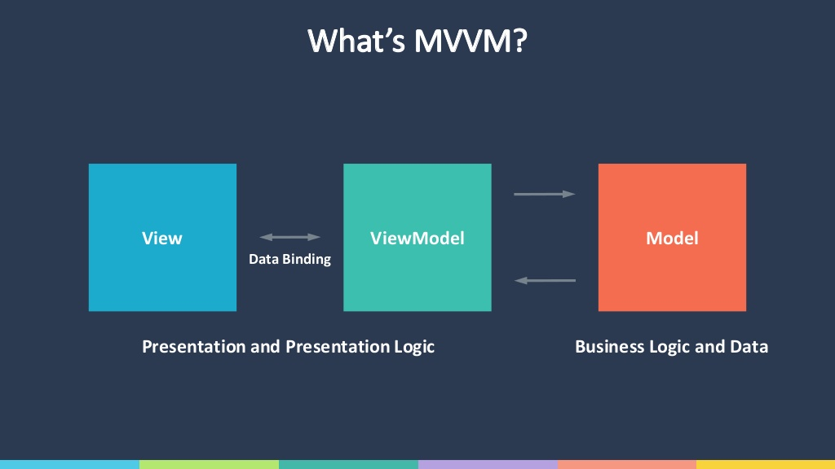
Clone or Download:
https://git.io/vPFem

Slide 7
Visual Studio users:
If you unzip the GitHub repo and open the HandsOnLab solution, you’ll probably get this build error on first build:
Files has invalid value obj\x86\Debug\DevDaysSpeakers.UWP.C_.Code.dev_days_labs_master.dev_days_labs_master.HandsOnLab.Finish.DevDaysSpeakers.DevDaysSpeakers.Shared.View.DetailsPage.xaml.g.cs
The specified path, file name, or both are too long. The fully qualified file name must be less than 260 characters ...
That filename = 167 characters
Path to obj folder = 104 characters
C:\Code\dev-days-labs-master\dev-days-labs-master\HandsOnLab\Finish\DevDaysSpeakers\DevDaysSpeakers.UWP\
167 + 104 = 271
Answer: shave off 12 characters from your path

